Slide 1
Footstep Classifier
Andrew Yu

Slide 2
Abstract
Objective: Using off-body sensors, classify footsteps to identify people
Motivation: Cool
Target Use Case: Security
Embedded ML Rationale: Low cost, low latency, private solution

Slide 3
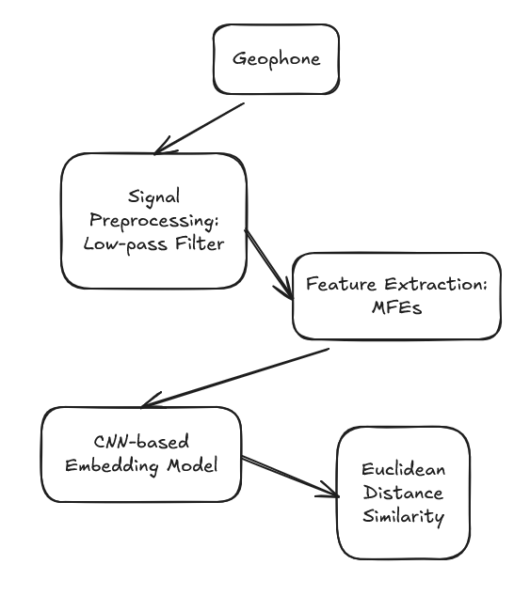

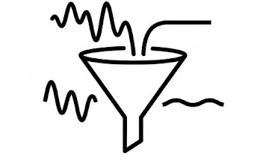

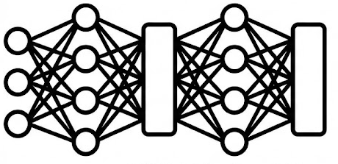
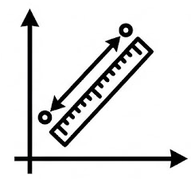
Architecture

Slide 4
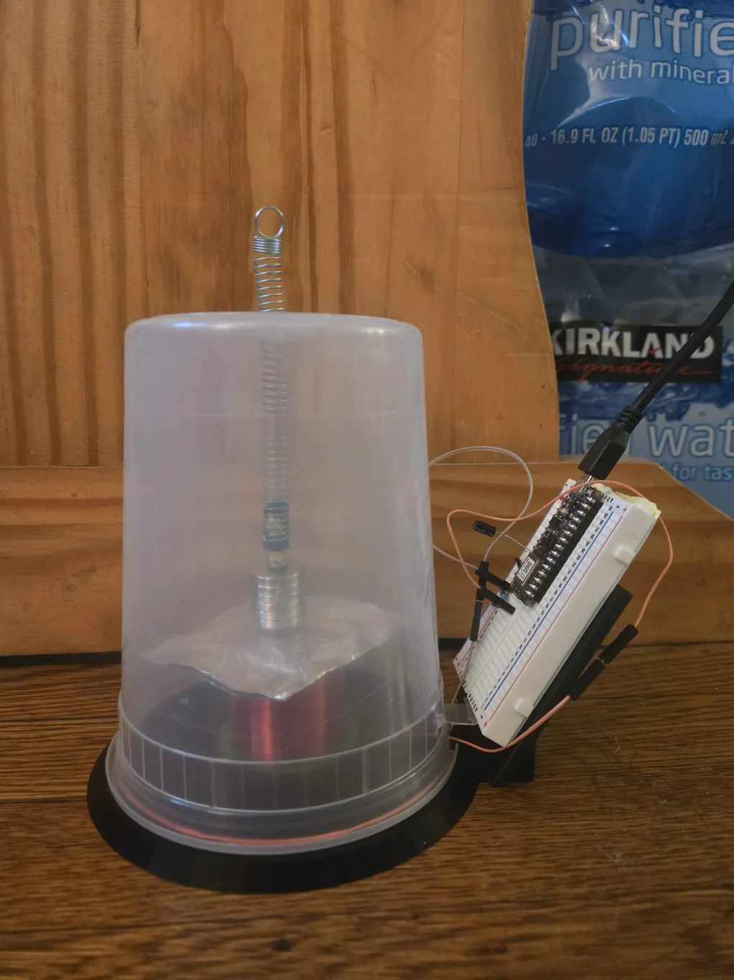
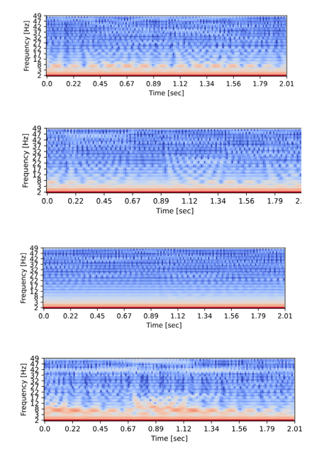
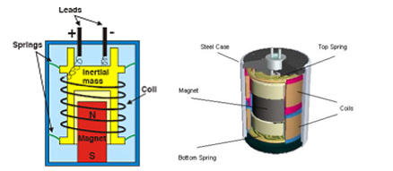
Data Collection
Sensor: Custom geophone
Preprocessing: Mel-filterbank energy features
Top-bottom: Andrew, Andy, None, Other

Slide 5
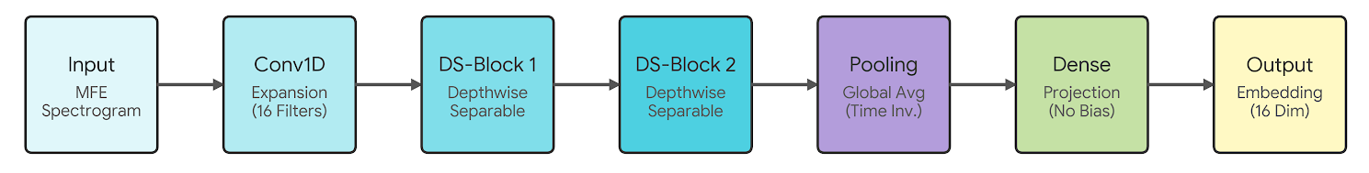
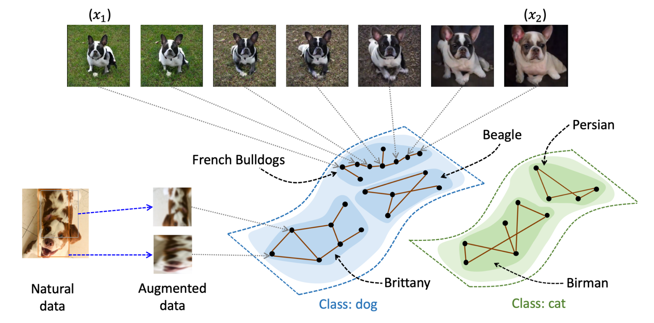
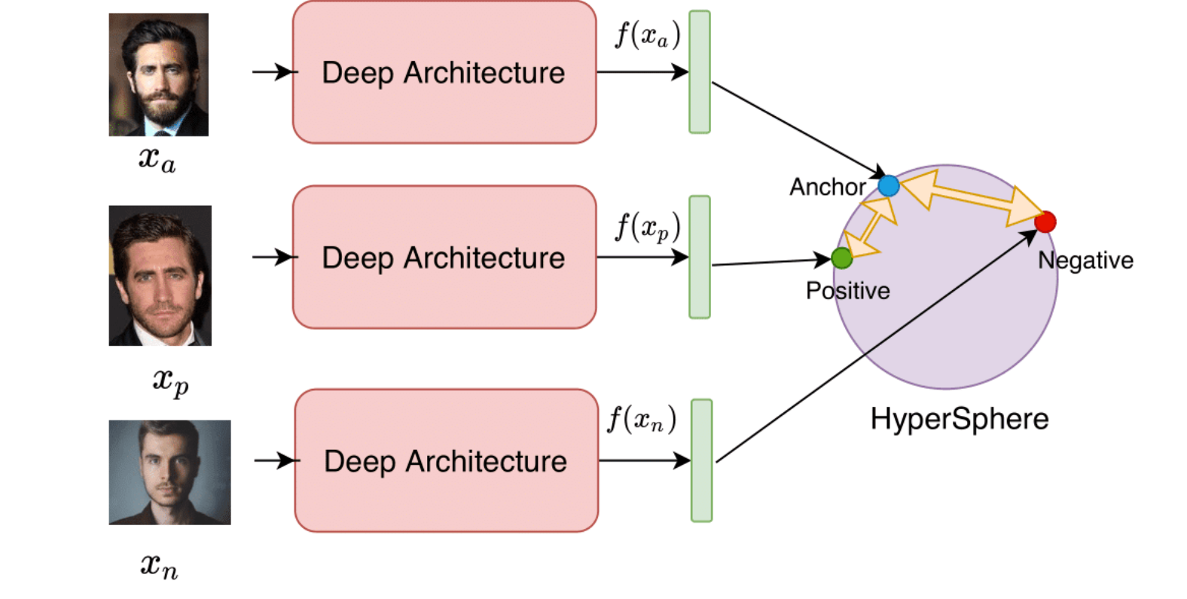
Model
Uses metric learning to generate embeddings from signal
Trained using triplet loss

Slide 6
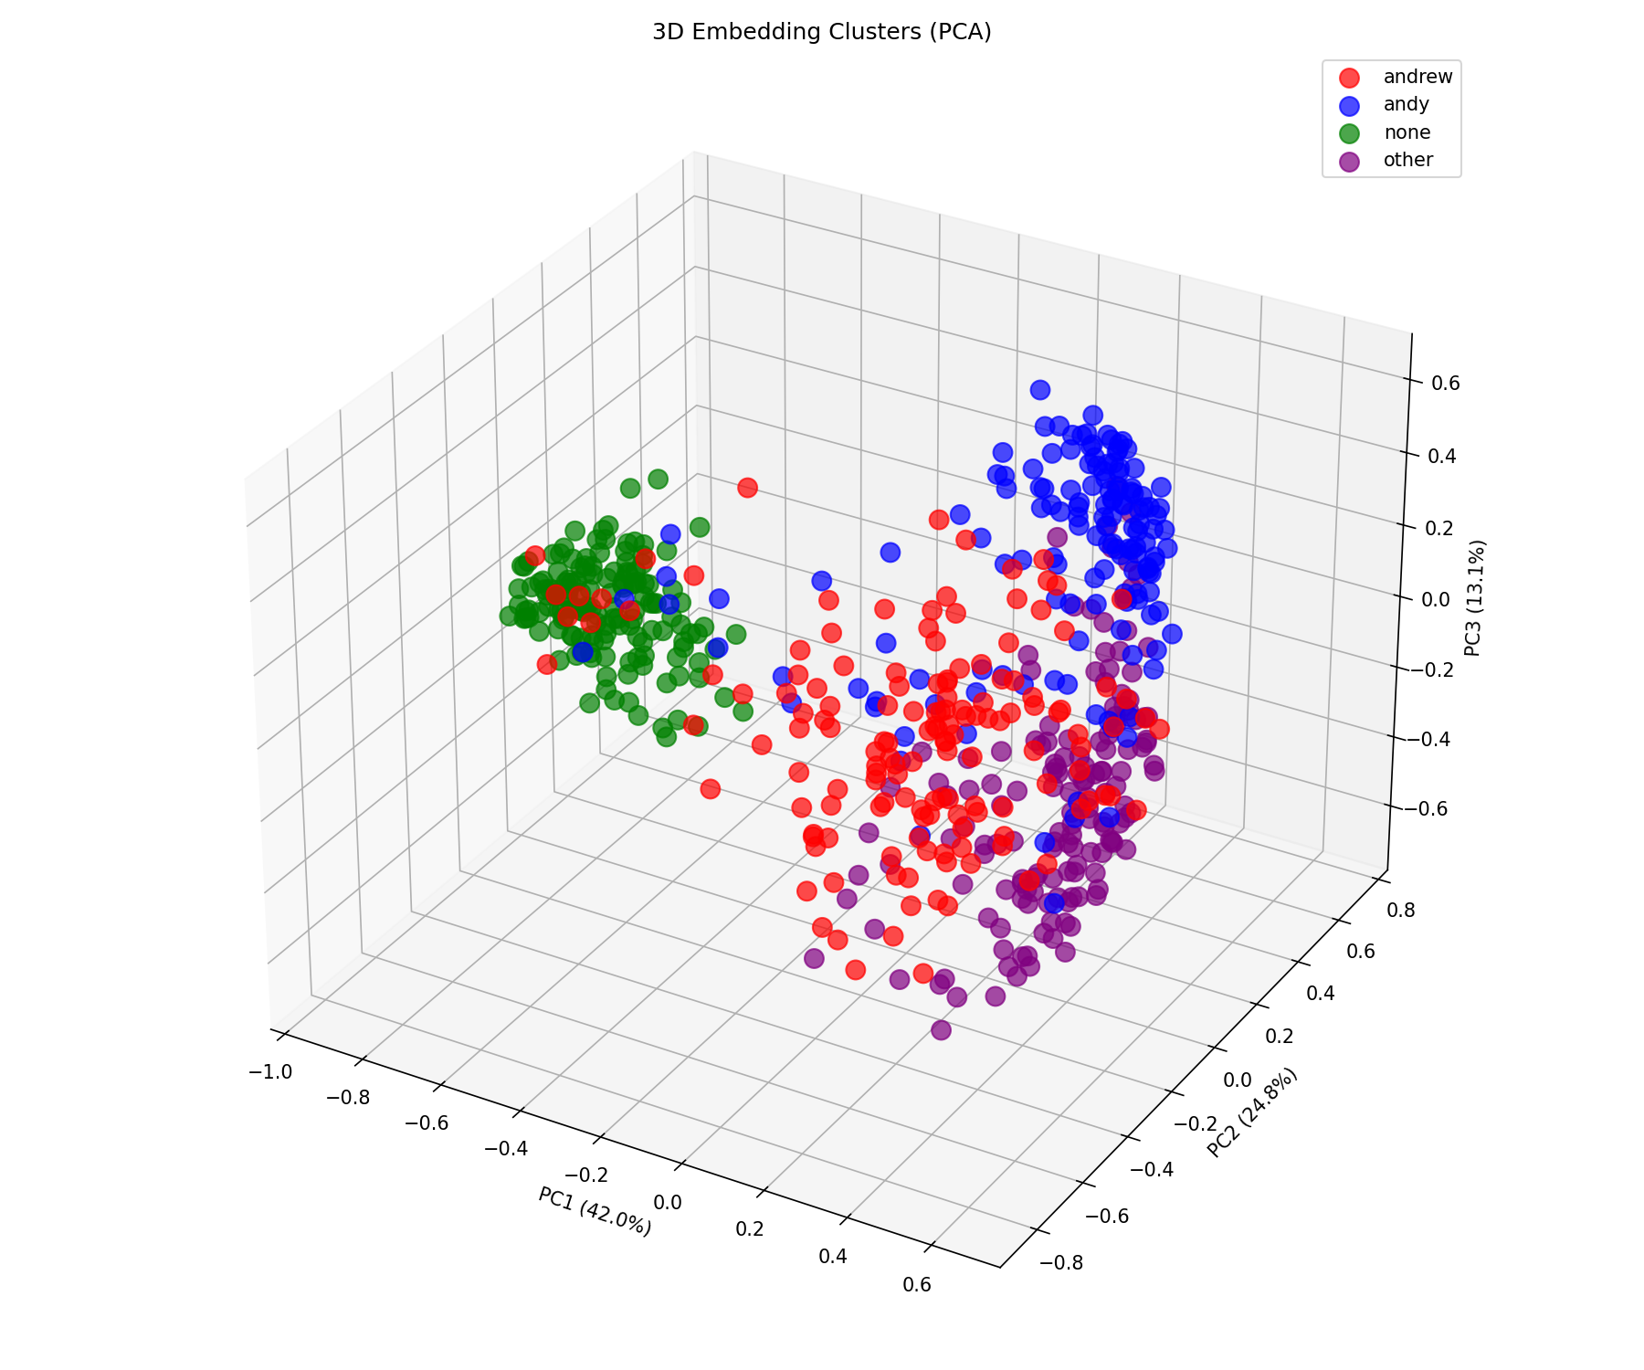
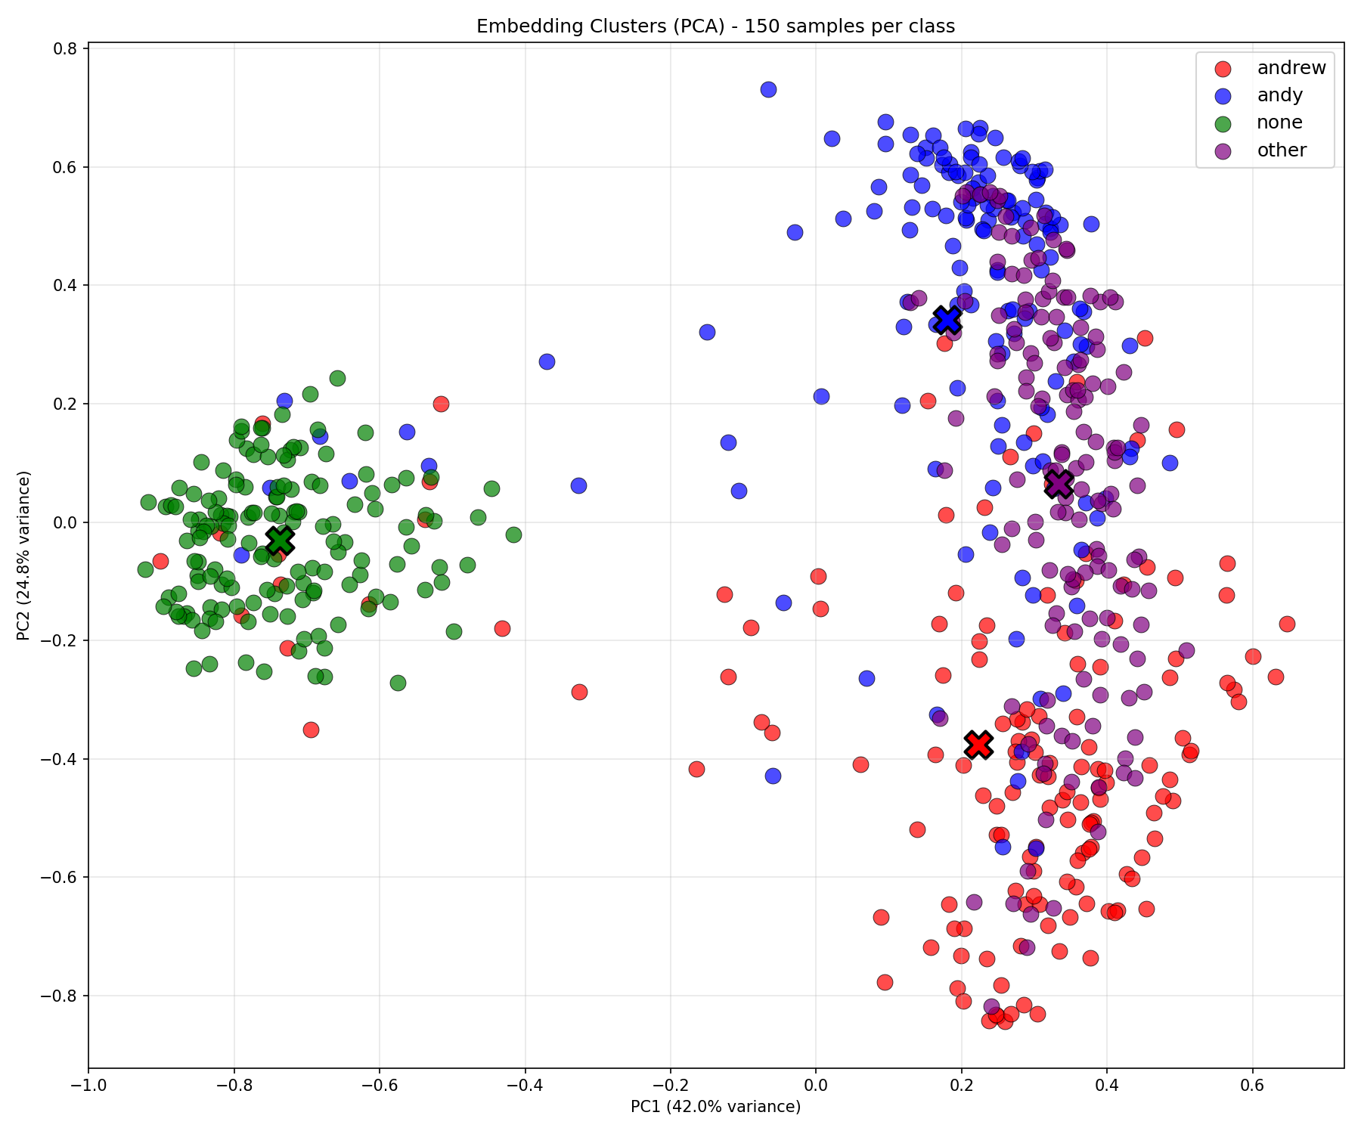
Results
Strong clustering of None
Weak clustering of Other

Slide 7
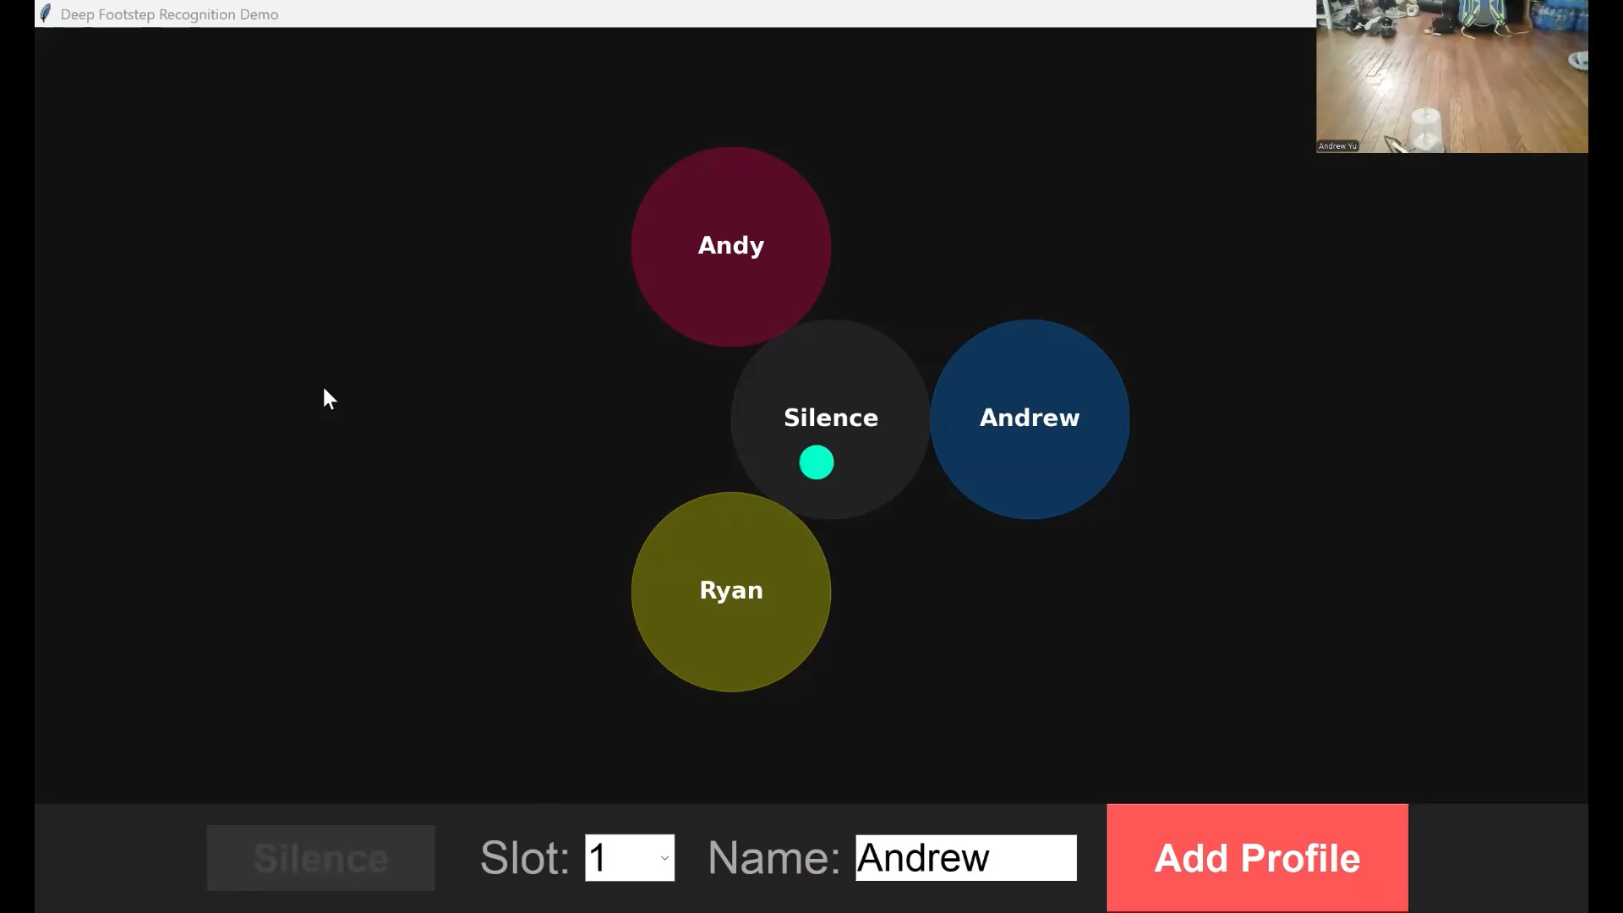
Inference: Andrew (Training Data)

Slide 8
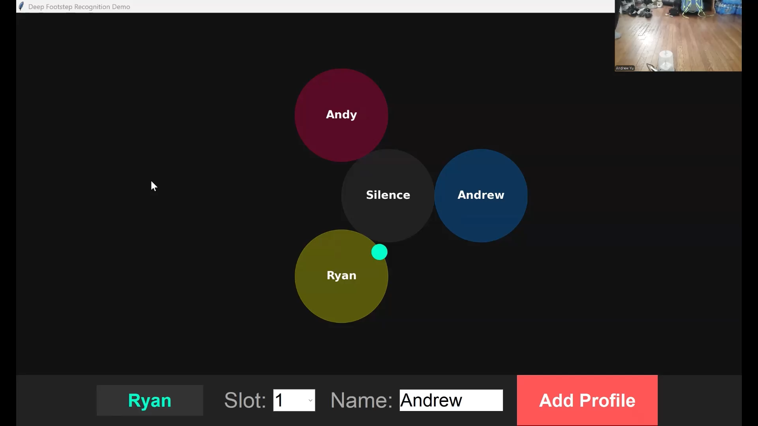
Inference: Ryan (Not Training Data)

Slide 9
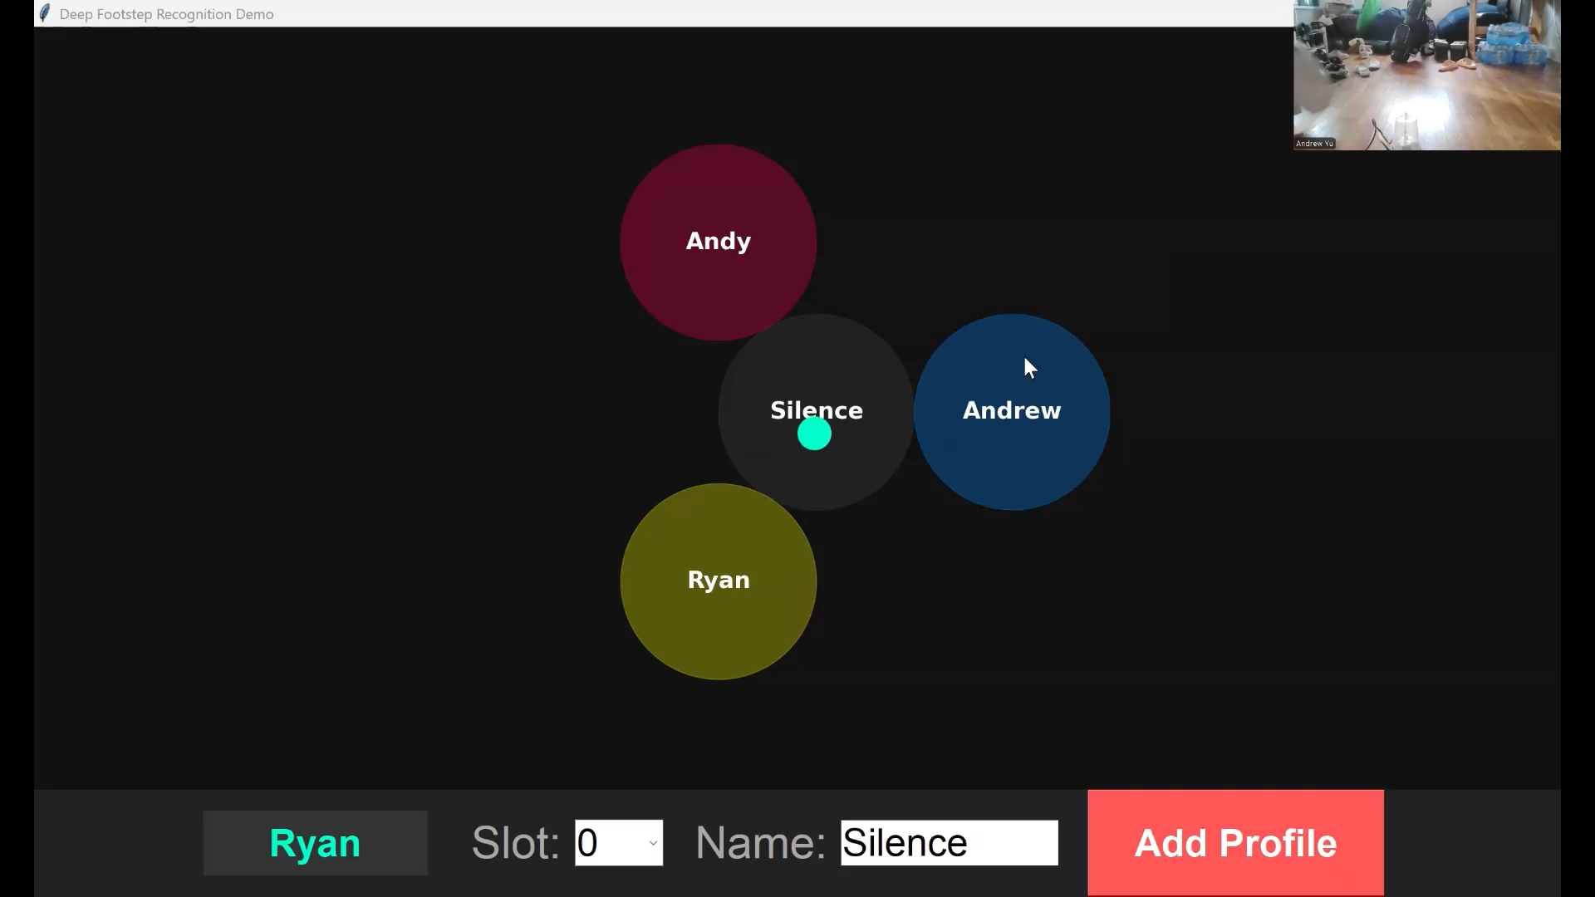
Inference: Andy (Training Data)

Slide 10
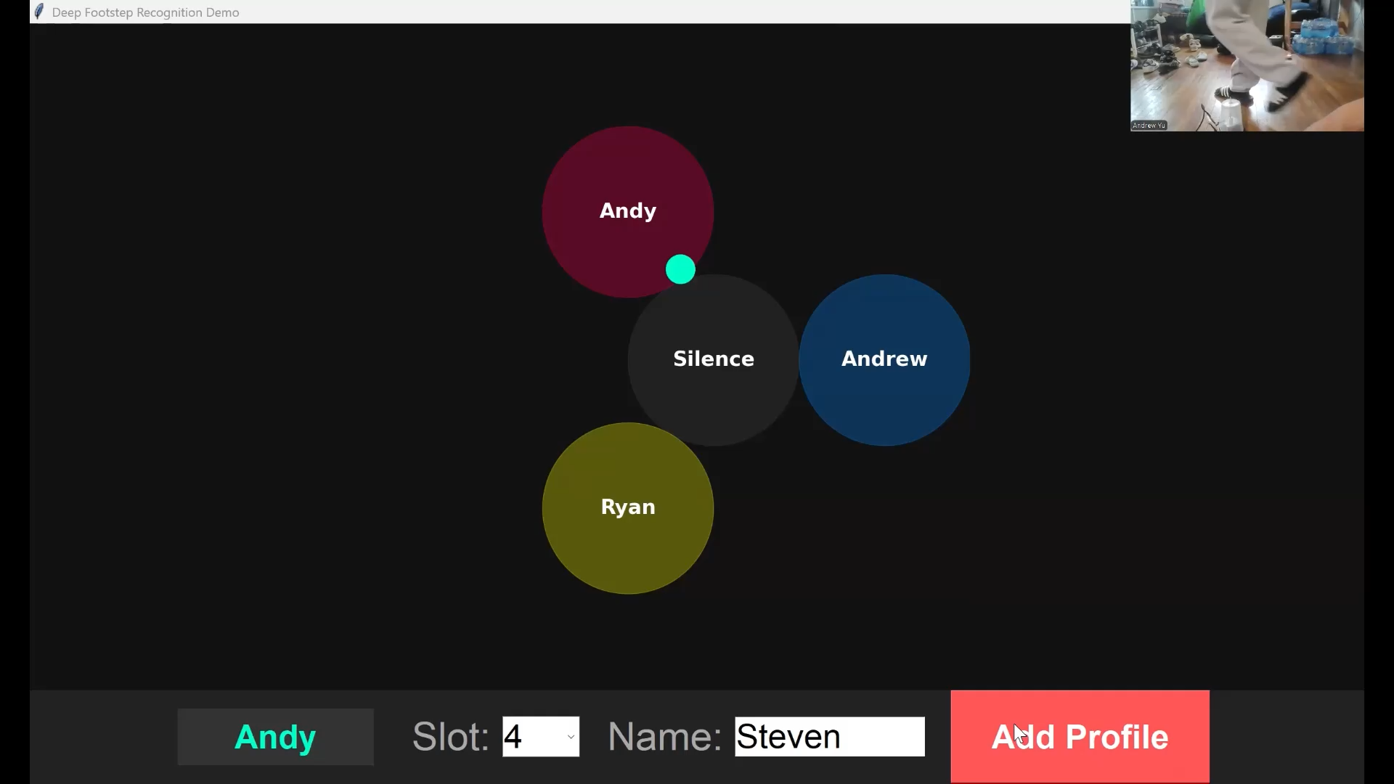
Inference: Steven (Not Training Data)

Slide 11
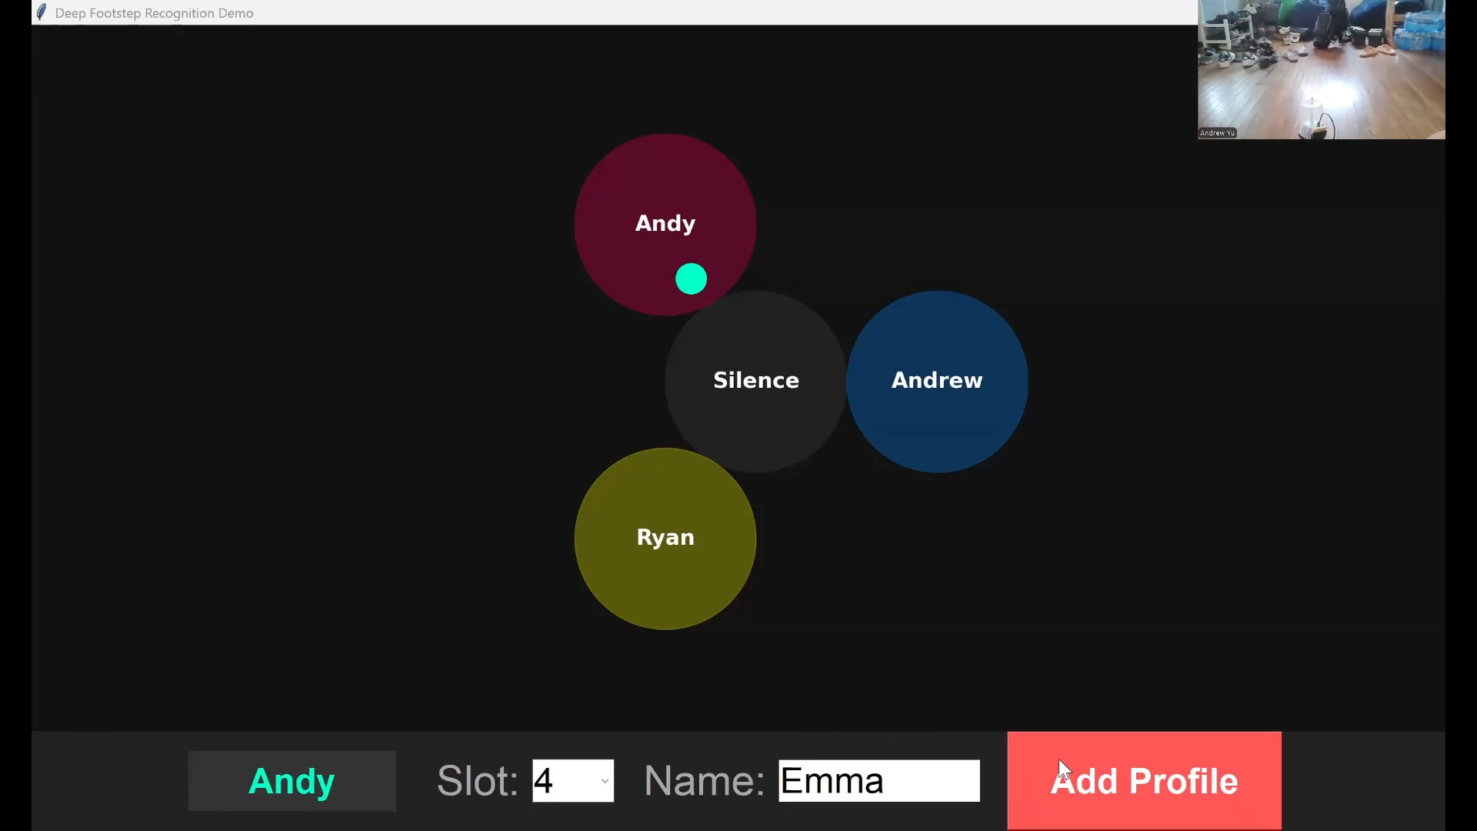
Inference: Emma (Not Training Data)

Slide 12
Challenges
Sensor:
Originally had piezoelectric disk which had poor sensitivity
Custom sensor was very experimental
Model:
Classification struggled to generalize different domains
Initial embedding model based on ResNet used too much memory
Clustering isn’t super strong

Slide 13
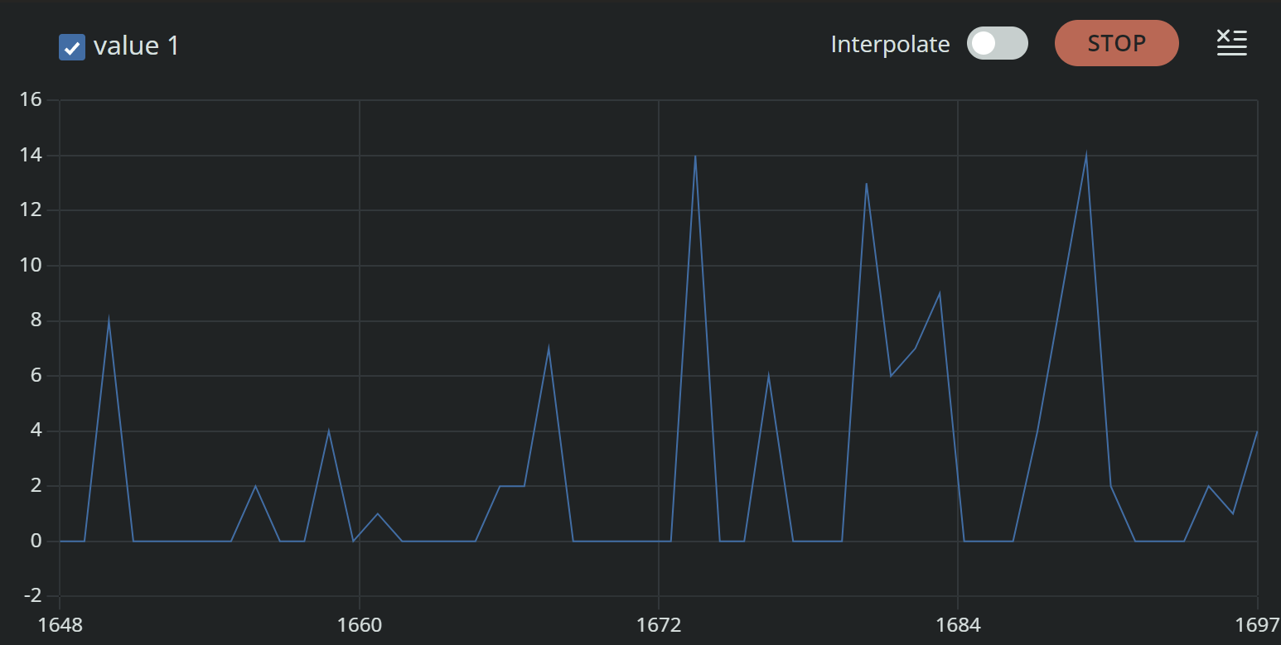
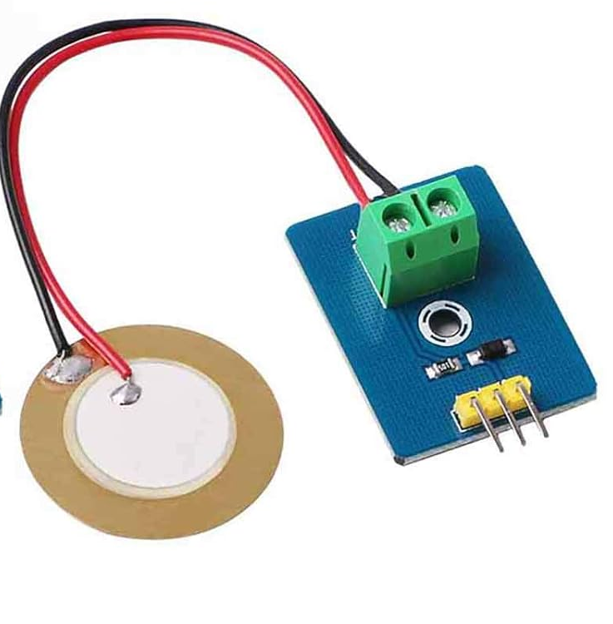
Piezoelectric Disk
Same results when walking and not walking

Slide 14
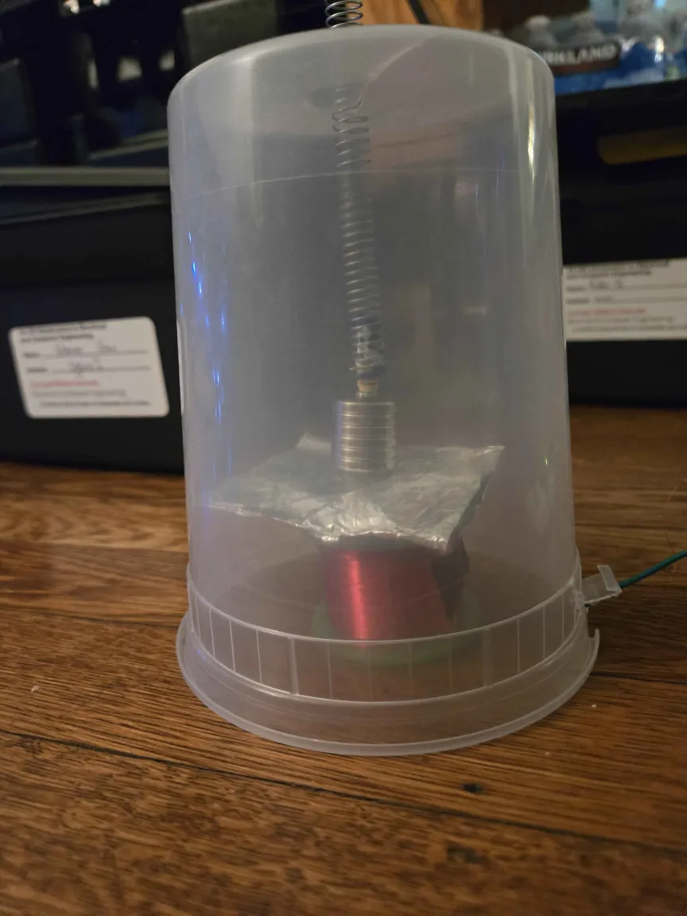
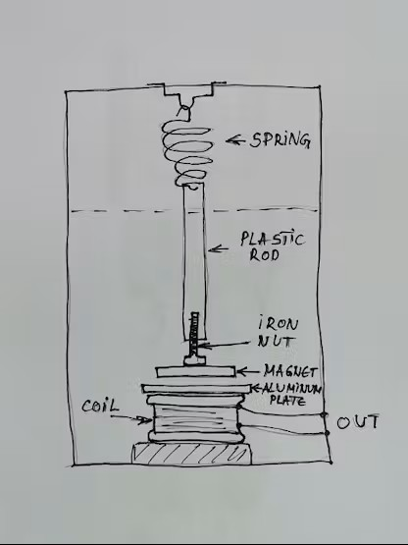
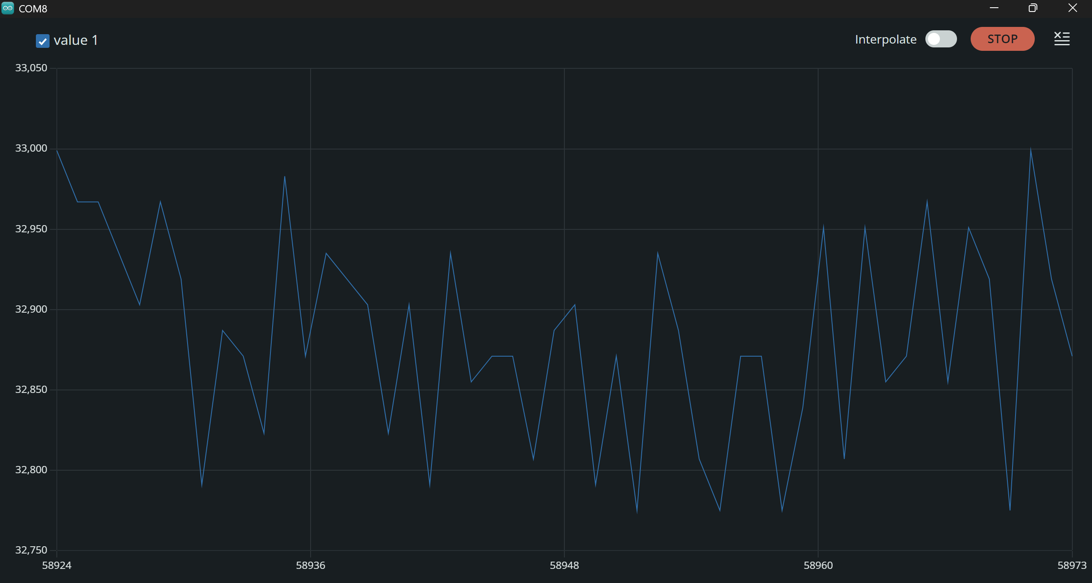
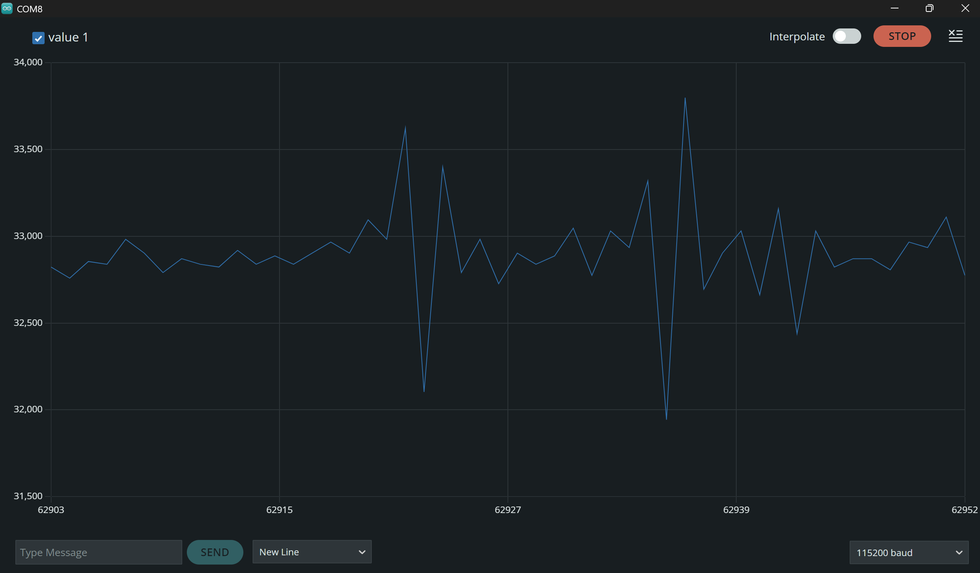
Geophone Design

Slide 15
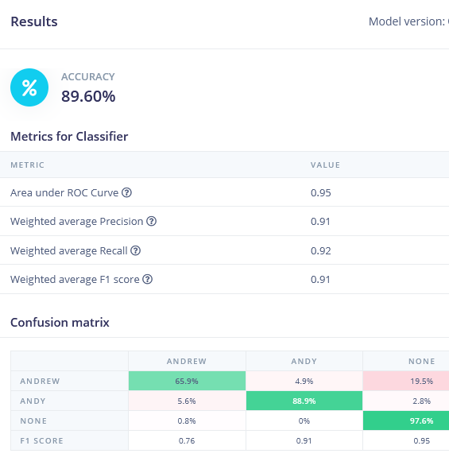
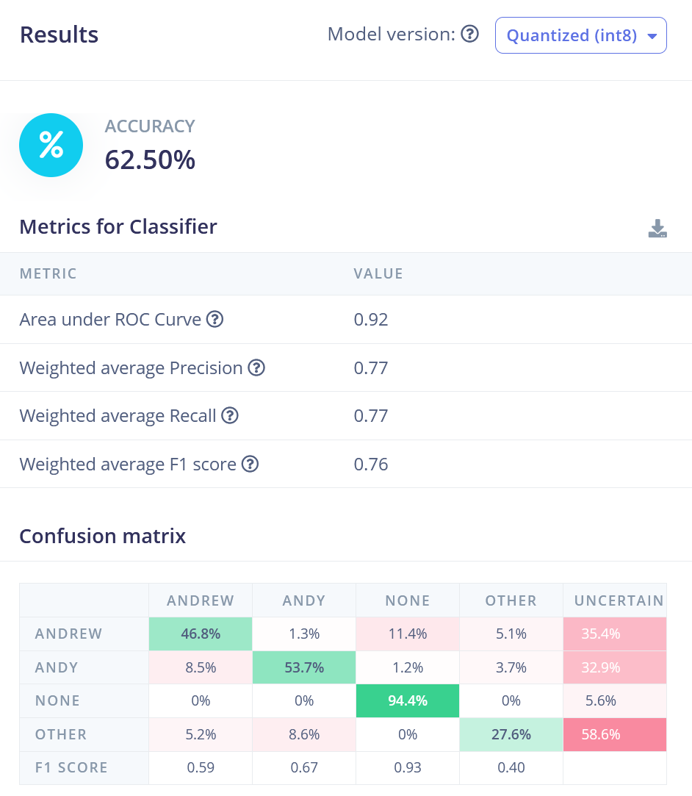
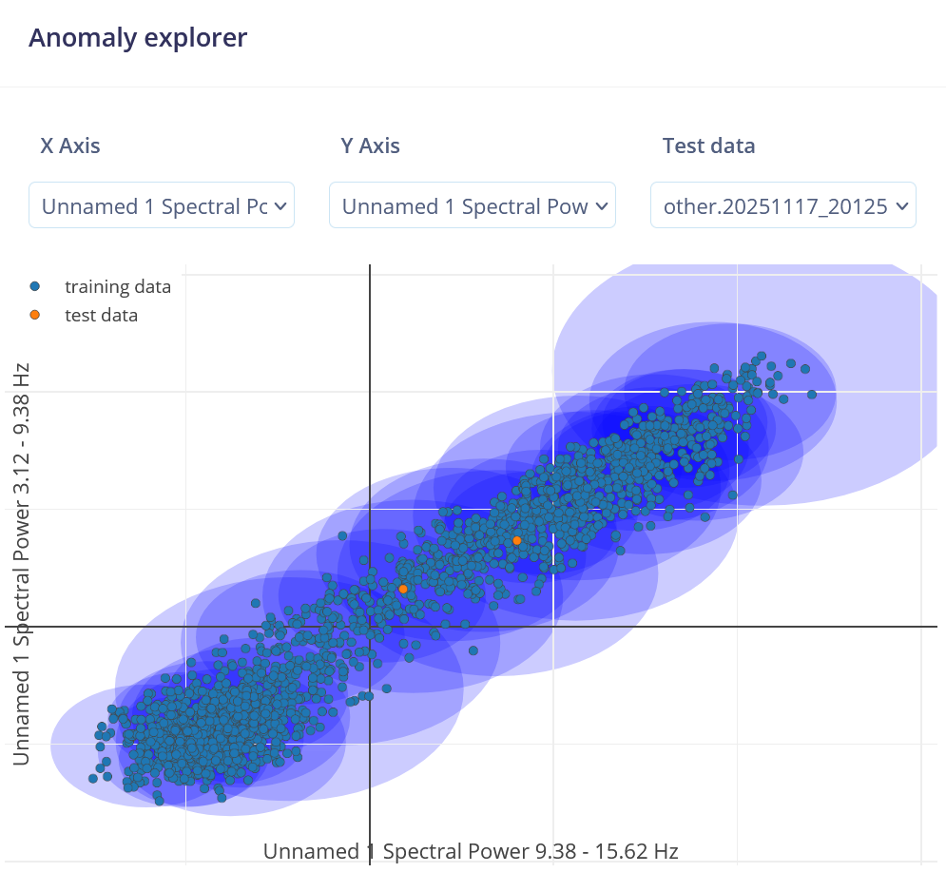
Classification Problems
Introduction of “other” class tanks performance, Naïve anomaly detection struggles

